Slide 1
Case Team 1
- The Foam Toppers
Aleeza Huda, Janna Rabanal, Will Lau, Colleene Kabaria, Zaki Cole, Abigail Aboah
May 17, 2024
WAYFAIR CONFIDENTIAL | 2024

Slide 2






Meet The Team:
Aleeza Huda
Northeastern Univ.
Janna Rabanal
The Univ. of Florida
Will Lau
UC Berkley
Colleene Kabaria
Rutgers Univ.
Zaki Cole
Univ. of Southern California
Abigail Aboah
Howard Univ.

Slide 3
Buyer Acquisition
White Labeling
Supplier Focus
Customer Experience
Overall Recommendation

Slide 4
1
Buyer Acquisition

Slide 5

Buyer Acquisition
The online mattress market is booming, and at Wayfair, we need to stay ahead of the curve.
Our goal? Partner with a mattress supplier who complements our strengths and aligns with our company goals.

Slide 6

Finding The Right Fit
Before attending the Las Vegas Trade Show, we prepped some key questions to ask potential suppliers:
Can you describe your company's online presence such as the ways you promote and sell your products?
To ensure efficient delivery times, can you elaborate on your warehouse network across the country?
What measures do you take to ensure the quality of your packing materials and the associated costs of packaging for orders?
What delivery methods do you offer for your products and are there options for expedited shipping or specific carrier preferences?

Slide 7

Choosing Our Champion
Supplier G
Supplier E
VS
Ship Speed: Small Package
# Units Sold: 1575
Lead Times: 48 Hours
Gross Margin in $: 54,219.375
Ship Speed: Small Package
# Units Sold: 2750
Lead Times: 2 - 3 Weeks
Gross Margin in $: 69,925

Slide 8
⭐ Supplier G
As Wayfair, one of the largest online home furnishing retail stores in the US, we need to do our best to deliver products to our customers successfully on the 1st try.
SHORT TERM - Loss of profit
LONG TERM - Supplier G would give faster lead time and shipping time (48 hours!), leads to improved customer satisfaction and brand reputation.
PEOPLE PRINCIPLES
“Seamless Company Experience” >> “Whether your order is big or small, you can expect to get it fast, on time, and just right.”

Slide 9
2
White Labeling

Slide 10
Curating a Selection
It is important that we pick the right selection to help our supplier white-label their products into an exclusive brand for Wayfair Sleep.
Notes:
We need to carefully evaluating the supplier's existing product offerings and selectively choosing items that meet Wayfair's quality standards and brand positioning to be repackaged and marketed as an exclusive Wayfair Sleep collection.

Slide 11
White Labeling
Data from Supplier:
Product A
Product C
High sales volume (2,000 units)
Relatively low average price ($100), making it more affordable (mass-market)
Lower-ish return rate (23.7%) compared to some other products
Decent inventory levels to support initial demand
Third highest sales volume (575 units)
Higher average price point ($349), allowing Wayfair Sleep to offer a premium option
Reasonable return rate (6.3%) for this price segment
Adequate inventory levels (400 OH, 300 OO)
Notes:
Product A:
- With 2,000 units sold, it demonstrates strong existing demand and popularity with customers and a proven sales record reduces risk when launching the new brand.
- The $100 average price point positions it as a more affordable, mass-market offering. Having a value-priced option allows Wayfair Sleep to appeal to budget-conscious shoppers.
- While the 23.7% return rate is not ideal, it’s relatively acceptable for this price segment.
- And we have a decent inventory starting pipeline to support initial Wayfair Sleep launch volumes
Product C:
- At 575 units sold, it has the third highest sales volume, indicating a healthy customer base already purchasing this higher-end product.
- The $349 average price allows Wayfair Sleep to present a premium, compared to lower-priced options like Product A.
- The 6.3% return rate is reasonable for this price tier and better than most products offered
- The inventory on hand and on order to the warehouse should cover early demand while additional inventory pipelines are established.

Slide 12
Important Questions to ask Suppliers:
1
How can we improve on different downfalls of each product?
Are there any current customer reviews/ratings for A and C on that provide insights into strengths/issues?
What lead times do we need to consider for ordering/receiving additional inventory of A and C?
What branding/marketing strategy is planned to highlight the differentiation of Wayfair Sleep vs. the existing Supplier G products?
2
3
4
Notes:
As we look to curate and build out our new exclusive Wayfair Sleep brand for mattresses, it's crucial that we thoroughly evaluate the product assortment from Supplier G to make the right selections.
1. We should ask the supplier proactively to understand how we can collaborate to improve any existing downfalls or pain points with their Products A and C that we may want to include in Wayfair Sleep. Having insights from customer reviews and ratings on those products' strengths and issues would further inform our evaluation.
3. Another key consideration is supply chain dynamics like lead times required for ordering and receiving additional inventory of A and C if we anticipate higher demand under the new Wayfair Sleep branding.
4. We need to carefully plan the marketing and branding strategy to clearly differentiate and position Wayfair Sleep as a premium, exclusive line compared to Supplier G's existing products on our site.

Slide 13
3
Supplier Focus
Notes:
Based on all the above questions being answered or analyzed, you’ve decided that you’d like to include Product D in Wayfair Sleep as well.

Slide 14
Question 3 – Supplier Focus
Q1:
Currently you are out of stock for an average of 20 days every 6 months, which results in a $17,000 loss in revenue. How can we ensure that your supply can meet our customers demand?
Notes:
Currently you are out of stock for an average of 20 days every 6 months, which results in a $17,000 loss in revenue. How can we ensure that the customer demand is meeting what you are able to supply?
6months * 11% = (2.64 weeks) → 20 days
775 units sold * $199 = ($54, 225 per 6 months) → $6,426 weekly rev

Slide 15
Question 3 – Supplier Focus
Q2:
Following current trends, ideally 3 shipments of 50 units is needed monthly to significantly reduce out of stock rates, is that something that is reasonable for you and your team? If not, would it be feasible to increase the number of inventory on order?
Notes:
Following current trends, ideally 3 shipments of 50 units is needed monthly to significantly reduce out of stock rates, is that something that is reasonable for you and your team?
***On avg- sales of 129.16 sold/month

Slide 16
Question 3 – Supplier Focus
Q3:
What could we as Wayfair do to support you and your team to increase production in order to ensure that the needs of our vast customer base are being met?
Notes:
What could we as Wayfair do to support you and your team to ensure that the needs of our vast customer base are being met?
Given the data points we just identified (Significant loss in potential revenue, High Out of Stock Rate, Low number of units On Order) … into question

Slide 17
4
Customer
Experience
Notes:
Looking at customer experience is critical when adding new products as it is a time that can cause significantly more website traffic.

Slide 18
How would you go about identifying pain points customers have when shopping for Mattresses?
Analyze mattress reviews across Wayfair brands
Gauge overall social media opinions on product (ie. reddit, twitter, etc.)
Cart abandonment rate
Track filters to identify customer preferences (ie. patterns/trends/sizes)
Track customer clicking on page to see needs
Notes:
During the shopping process there is a few different ways we think would be beneficial to identifying pain points customers are facing.
Wayfair has a vast array of mattresses offered and past reviews should be leveraged in seeing what common customer pain points were met
As public apps like reddit, glassdoor, twitter, and more become popularized it is key to use this information to the companies advantage as it is an easy way to collect customer pain points
Cart abandonment rate is crucial to analyze as a lot of the times there are trends in items that do not meet customer pain points and certain products that are consistently left in the cart or instead chosen over others
Tracking filters chosen by customers such as patterns, societal trends, and sizes can also tell a company a lot about pain points.
Similarly, tracking customer clicking and engagement in general tells a lot about their needs and why exactly they are in the market for a product. Leveraging this information could be quite beneficial in recommending desired products quickly to the customer.

Slide 19



Where in the online shopping experience could customers give feedback?
Our Goal: ask for feedback consistently throughout the buying process
In app feedback
Mid purchase ratings
Post purchase survey
Notes:
With the goal in mind for high customer retention rates as well as growing customer brand loyalty it is key to consistently ask for feedback throughout the entire buying process.
The three approaches we thought to be most beneficial is a 1-5 star rating during the middle of the purchasing process. A good time for this would likely be 10 minutes into a customers scrolling on the website, that simply asks if the recommended products are at all relevant to them. If < 3 stars the algorithm refresh its top recommendations for the customer.
Similarly, post the purchasing journey, a quick pop up survey while customers confirm their order could significantly increase the numbers of customers giving helpful feedback, better helping Wayfair
Lastly, for users shopping on the app and not the website itself, in app feedback whether that be comments, star ratings, or more would be critical to analyze.

Slide 20

Online Shopping can be difficult

Slide 21
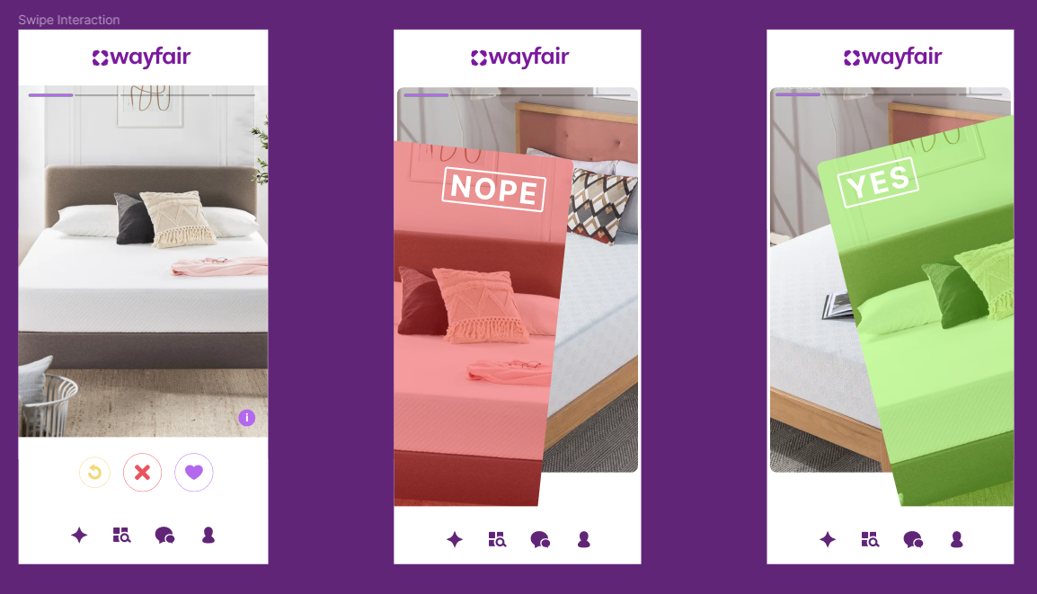
Introducing WaySwipe
Notes:
4d)
First Idea:
Great, switching gears, when we think about certain approaches to the Search & Recommendation Team, our biggest focal point is always to further Wayfair’s people principle of relentless customer focus. Many times when we want to improve a feature, we don’t consider the implications on how certain platforms impact how it rolls out.
We all know that usually people on their phone are simply lounging around scrolling, maybe got a Wayfair snack they brought from the snack wall, while on the other hand, people shopping on the desktop are more likely to be committed to purchasing.
That’s why for our mobile platform, we imagine WaySwipe! Essentially Tinder… but for furniture. We wanted to approach this by improving an existing model because it has been proven that it’s feasible and it already works, BUT not just exclusive to purchase history, what’s in the current cart, or what was browsed. While this is useful, we can expand on our customer personalization as a company to really ensure a home for all. As a result, we aim to extend this algorithm to incorporate the favorites list. By having a Tinder-like model for the phone, our machine learning model can be trained on the user swiping data, allowing for the selection to be narrowed down over more and more time and uses, and as a result it gives more of a personalization for the customer themselves. While doing this, it also allows for a gamified version of browsing, something that specifically targets people that don’t necessarily know what they desire in a mattress. As for the desktop, we continue to train this algorithm on the favorites, ensuring that when they click on the browse button, narrowed down selections made by the ML model are pushed to the top, giving us two distinctly different customer experiences for two different customer needs. And I’ll kick it back to Abby to explain what we have next.
Boy, does that mattress blow me away?
Second Idea:
The main challenge that appears is acknowledging that reviews come in a wide spectrum and not just a simple linear formula. However, by choosing to focus on specific keywords for our customer reviews, we can use GenAI to aggregate these groups of text, allowing our reviews to now be labeled, giving us a data mined summary. Now that the reviews are put in a cleaned and consistent form, this enables us to feed this to our search and recommendation engine based on common keywords. So now, suppose Manu has a slight idea that he wants a slightly firm mattress with cooling technology. With our refined search bar, these past summarized reviews can be leveraged to…
More accurately describe what the product is to the user
Along with this, as mentioned before, return rate is one of our biggest focuses,

Slide 22
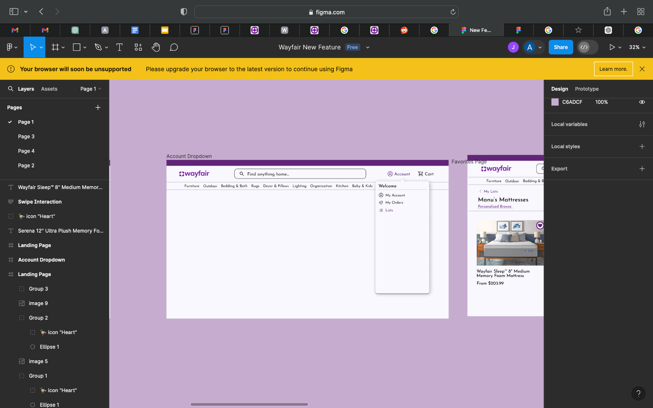
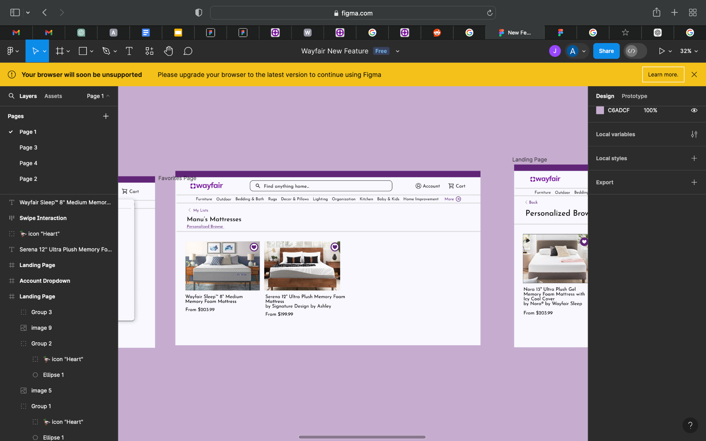
Manus List
Notes:
4d)
First Idea:
Great, switching gears, when we think about certain approaches to the Search & Recommendation Team, our biggest focal point is always to further Wayfair’s people principle of relentless customer focus. Many times when we want to improve a feature, we don’t consider the implications on how certain platforms impact how it rolls out.
We all know that usually people on their phone are simply lounging around scrolling, maybe got a Wayfair snack they brought from the snack wall, while on the other hand, people shopping on the desktop are more likely to be committed to purchasing.
That’s why for our mobile platform, we imagine WaySwipe! Essentially Tinder… but for furniture. We wanted to approach this by improving an existing model because it has been proven that it’s feasible and it already works, BUT not just exclusive to purchase history, what’s in the current cart, or what was browsed. While this is useful, we can expand on our customer personalization as a company to really ensure a home for all. As a result, we aim to extend this algorithm to incorporate the favorites list. By having a Tinder-like model for the phone, our machine learning model can be trained on the user swiping data, allowing for the selection to be narrowed down over more and more time and uses, and as a result it gives more of a personalization for the customer themselves. While doing this, it also allows for a gamified version of browsing, something that specifically targets people that don’t necessarily know what they desire in a mattress. As for the desktop, we continue to train this algorithm on the favorites, ensuring that when they click on the browse button, narrowed down selections made by the ML model are pushed to the top, giving us two distinctly different customer experiences for two different customer needs. And I’ll kick it back to Abby to explain what we have next.
Boy, does that mattress blow me away?
Second Idea:
The main challenge that appears is acknowledging that reviews come in a wide spectrum and not just a simple linear formula. However, by choosing to focus on specific keywords for our customer reviews, we can use GenAI to aggregate these groups of text, allowing our reviews to now be labeled, giving us a data mined summary. Now that the reviews are put in a cleaned and consistent form, this enables us to feed this to our search and recommendation engine based on common keywords. So now, suppose Manu has a slight idea that he wants a slightly firm mattress with cooling technology. With our refined search bar, these past summarized reviews can be leveraged to truly gauge customer sentiment. For example in the slide before…
More accurately describe what the product is to the user
Along with this, as mentioned before, return rate is one of our biggest focuses,

Slide 23

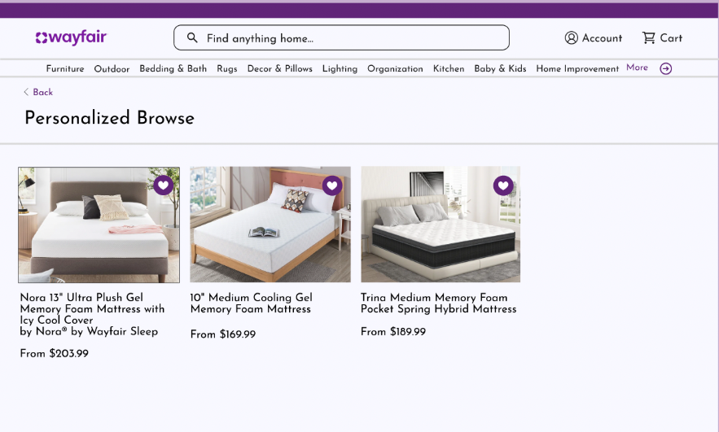
Personalized Browse

Slide 24
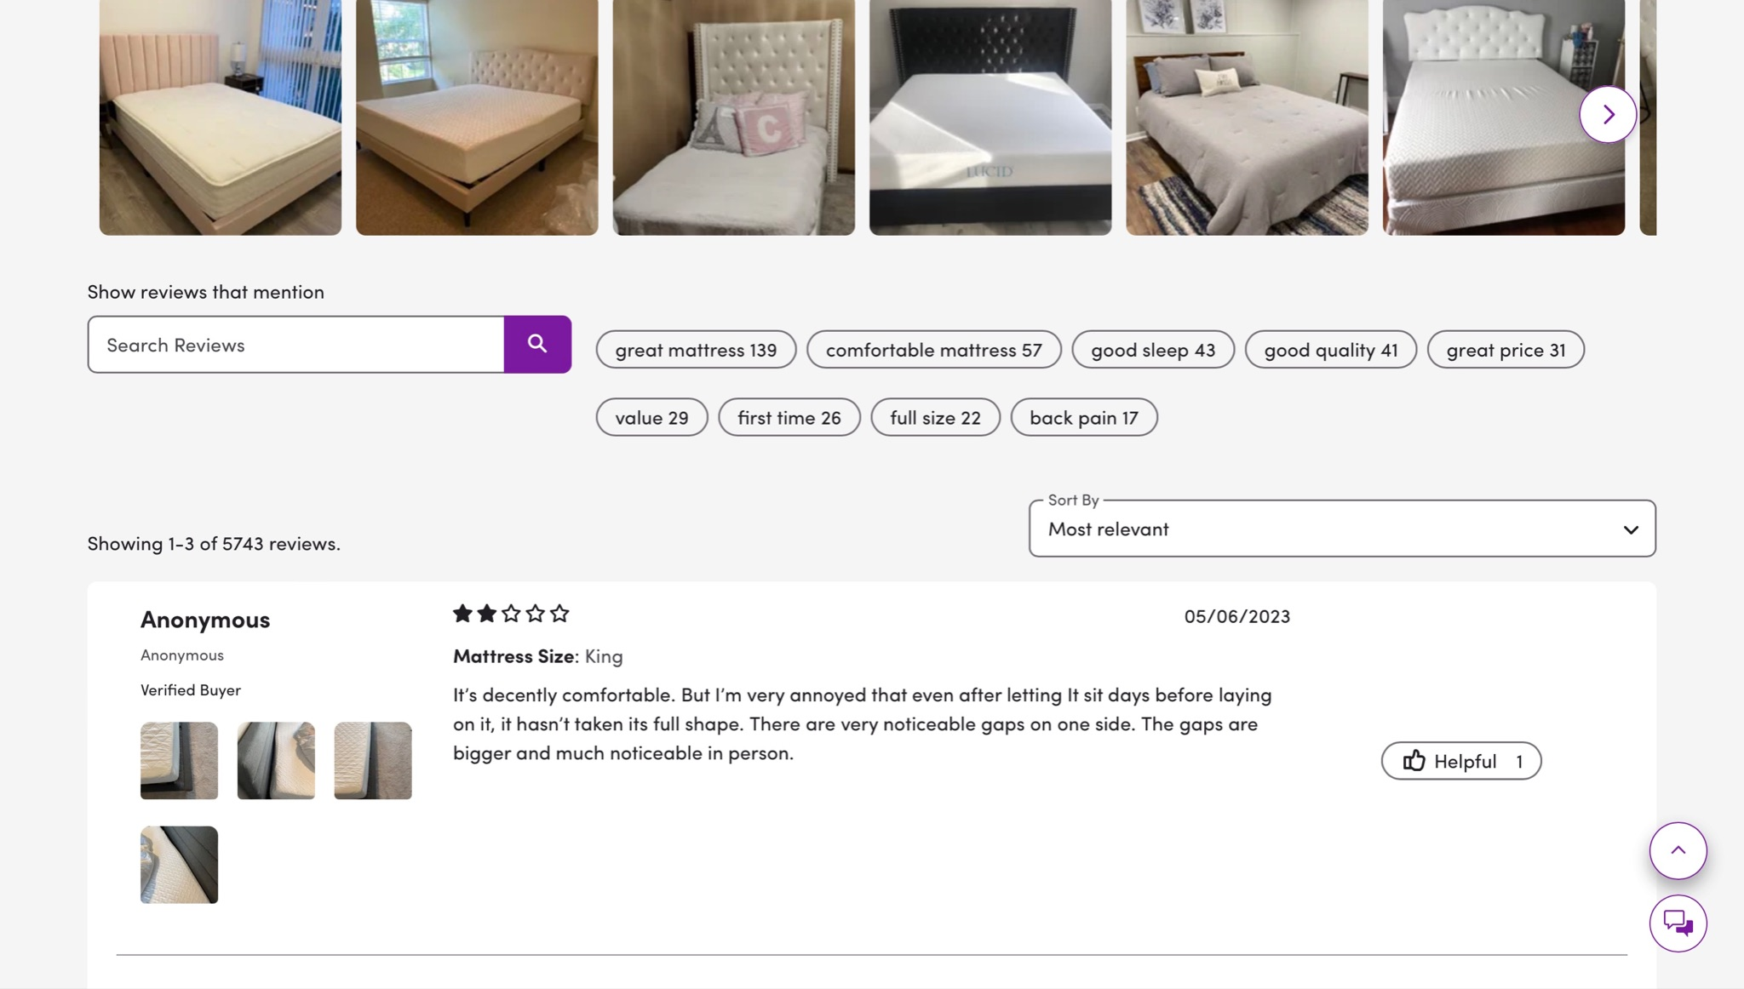
A second proposed engineering solution

Slide 25



Pipeline of Refined System using GenAI
Focus on Keywords in Customer Reviews
Aggregate using GenAI leading to cleaned form
Refined Search & Recommendation using metadata

Slide 26
5
Final Recommendations

Slide 27

Final Insights
Customer Focus
Increased User Engagement
Personalization
Cost Efficiency
Brand Reputation
Minimizing Return Rate
Maintaining Competitive Edge
Experimentation/Taking Risks
Staying Ahead
Notes:
We drive results… (Cost reduction)

Slide 28






Colleene Kabaria
Janna
Rabanal
Abigail
Aboah
Thank You!
Pssst~ Connect With Us on LinkedIn
Will
Lau
Zaki
Cole
Aleeza
Huda

Slide 29
Buyer Acquisition
1a. What questions would you come prepared to ask potential new suppliers to determine if they would be a strategic partner to onboard within the Mattress space?
1b. The trade show proved to be successful as you have identified 4 suppliers that would be eligible to work with Wayfair. Below you will find relevant data on current and potential suppliers. You are only able to bring on one additional supplier at this time; which supplier would you select and why? Use the data in Exhibit 1 to help determine your answer and complete the Estimated Revenue + Gross Margin % fields to help.
Question 1

Slide 30
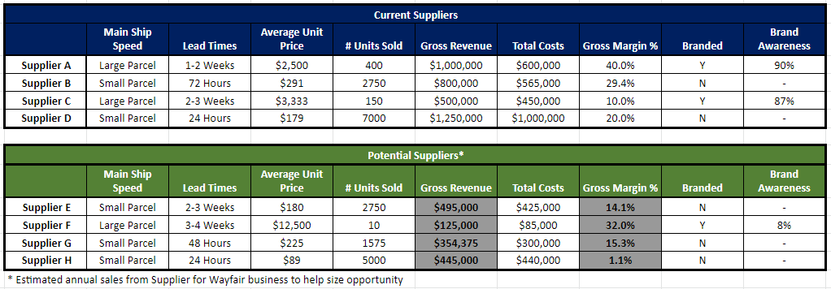
Buyer Acquisition: Exhibit - Question 1B
*Slide #’s are fictional
Notes:
Focus on:
Maintain Competitive price
Great delivery experience
Drive incremental sales and not shift $ amongst your current assortment.
Support demand for ONLINE shopping
GM (Gross Margin) in Dollars
⭐E - 69,925
⭐⭐G - 54,219.375
F - 40,000
H - 4,895
WHY G
As Wayfair, one of the largest online home furnishing retail stores in the US, we need to do our best to deliver products to our customers successfully on the 1st try
We are sacrificing a bit of profit FOR a lead time/faster shipping time = improved customer satisfaction and brand reputation
Short term: loss of profit compared to supplier E around 15.8k
Long term: The more we retain customer satisfaction and brand reputation, we can grow our profits and customer pool
PEOPLE PRINCIPLES > Customer focus coz no customer no company
“Seamless Company Experience” > “Whether your order is big or small, you can expect to get it fast, on time, and just right.”
How do we ensure quality of product delivery/shipment?
KNOWN: bulky and damage prone products required tailored delivery and customer service
Ask the suppliers delivery quality control and unique product point questions for 1A:
Can you describe your company's online presence? How do you typically promote and sell your products?
Gauges how we can improve/apply marketing strategies to enhance or maintain a companies online presence
To ensure efficient delivery times, can you elaborate on your warehouse network across the country? How does the location of your warehouses impact shipping timelines?
(Focus on warehouse delivery speed and storage optimization.)
What measures do you take to ensure the quality of your packing materials? Additionally, could you provide information on the associated costs of packaging for potential orders?
(About packing materials to emphasize quality control and combines it with the question about cost.)
What delivery methods do you offer for your products? Are there options for expedited shipping or specific carrier preferences?
(Understand the suppliers delivery methods with a focus on options and flexibility for differentiation.)

